Slide 1
Ethics in Information Technology, Fourth Edition
Computer and Internet Crime
Chapter 3
Notes:
1

Slide 2
Objectives
As you read this chapter, consider the following questions:
  What key trade-offs and ethical issues are associated with the safeguarding of data and information systems?
  Why has there been a dramatic increase in the number of computer-related security incidents in recent years?
  What are the most common types of computer security attacks?
Ethics in Information Technology, Fourth Edition
Notes:
2

Slide 3
Objectives (cont’d.)
  Who are the primary perpetrators of computer crime, and what are their objectives?
Ethics in Information Technology, Fourth Edition
Notes:
3

Slide 4
IT Security Incidents: A Major Concern
Security of information technology is of utmost importance
  Safeguard:
    Confidential business data
    Private customer and employee data
  Protect against malicious acts of theft or disruption
  Balance against other business needs and issues
Number of IT-related security incidents is increasing around the world
Ethics in Information Technology, Fourth Edition
Notes:
4

Slide 5
Why Computer Incidents Are So Prevalent
Increasing complexity increases vulnerability
  Computing environment is enormously complex
    Continues to increase in complexity
    Number of entry points expands continuously
    Cloud computing and virtualization software
Higher computer user expectations
  Computer help desks under intense pressure
    Forget to verify users’ IDs or check authorizations
Computer users share login IDs and passwords
Ethics in Information Technology, Fourth Edition
Notes:
5

Slide 6
Why Computer Incidents Are So Prevalent (cont’d.)
Expanding/changing systems equal new risks
  Network era
    Personal computers connect to networks with millions of other computers
    All capable of sharing information
  Information technology
    Is everywhere
    Necessary tool for organizations to achieve goals
    Increasingly difficult to match pace of technological change for risk assessment
Ethics in Information Technology, Fourth Edition
Notes:
6

Slide 7
Why Computer Incidents Are So Prevalent (cont’d.)
Increased reliance on commercial software with known vulnerabilities
  Exploit
    Attack on information system
    Takes advantage of system vulnerability
    Due to poor system design or implementation
  Patch
    “Fix” to eliminate the problem
    Users are responsible for obtaining and installing
    Delays expose users to security breaches
Ethics in Information Technology, Fourth Edition
Notes:
7

Slide 8
Why Computer Incidents Are So Prevalent (cont’d.)
Zero-day attack
  Before a vulnerability is discovered or fixed
U.S. companies rely on commercial software with known vulnerabilities
Ethics in Information Technology, Fourth Edition
Notes:
8

Slide 9
Types of Exploits
Computers as well as smartphones can be target
Types of attacks
  Virus
  Worm
  Trojan horse
  Distributed denial of service
  Rootkit
  Spam
  Phishing (spear-phishing, smishing, and vishing)
Ethics in Information Technology, Fourth Edition
Notes:
9

Slide 10
Viruses
Pieces of programming code
Usually disguised as something else
Cause unexpected and undesirable behavior
Often attached to files
Deliver a “payload”
Spread by actions of the “infected” computer user
    Infected e-mail document attachments
    Downloads of infected programs
    Visits to infected Web sites
Ethics in Information Technology, Fourth Edition
Notes:
10

Slide 11
Worms
Harmful programs
  Reside in active memory of a computer
  Duplicate themselves
Can propagate without human intervention
Negative impact of worm attack
  Lost data and programs
  Lost productivity
  Additional effort for IT workers
Ethics in Information Technology, Fourth Edition
Notes:
11

Slide 12
Trojan Horses
Malicious code hidden inside seemingly harmless programs
Users are tricked into installing them
Delivered via email attachment, downloaded from a Web site, or contracted via a removable media device
  Some pirated copies of this software contain a Trojan horse
Logic bomb
  Executes when triggered by certain event
Ethics in Information Technology, Fourth Edition
Notes:
12

Slide 13
Distributed Denial-of-Service (DDoS) Attacks
Malicious hacker takes over computers on the Internet and causes them to flood a target site with demands for data and other small tasks
  The computers that are taken over are called zombies
  Botnet is a very large group of such computers
Does not involve a break-in at the target computer
  Target machine is busy responding to a stream of automated requests
  Legitimate users cannot access target machine
Ethics in Information Technology, Fourth Edition
Notes:
13

Slide 14
Rootkits
Set of programs that enables its user to gain administrator-level access to a computer without the end user’s consent or knowledge
Attacker can gain full control of the system and even obscure the presence of the rootkit
Fundamental problem in detecting a rootkit is that the operating system currently running cannot be trusted to provide valid test results
Ethics in Information Technology, Fourth Edition

Slide 15
Rootkits
symptoms of rootkit infections:
  • The computer locks up or fails to respond to input from the keyboard or mouse.
  • The screen saver changes without any action on the part of the user.
  • The taskbar disappears.
  • Network activities function extremely slowly.
Ethics in Information Technology, Fourth Edition

Slide 16
Spam
Abuse of email systems to send unsolicited email to large numbers of people
  Low-cost commercial advertising for questionable products
  Method of marketing also used by many legitimate organizations
Controlling the Assault of Non-Solicited Pornography and Marketing (CAN-SPAM) Act
  Legal to spam if basic requirements are met
Ethics in Information Technology, Fourth Edition

Slide 17
Spam (cont’d.)
Completely Automated Public Turing Test to Tell Computers and Humans Apart (CAPTCHA)
  Software generates tests that humans can pass but computer programs cannot
Ethics in Information Technology, Fourth Edition

Slide 18
Spam (cont’d.)
For nearly five years, Edward Davidson ran a spamming, he managed a large network of computers that sent hundreds of thousands of spam e-mails, promoted the sale of watches, perfume, and other items for nearly two dozen companies. Davidson and his subcontractors sent e-mail messages with header information that concealed the actual sender from the recipient of the e-mail—a violation of the federal CAN-SPAM Act. In April 2008, Edward Davidson was sentenced to serve 21 months in federal prison for violation of the CAN-SPAM Act. He was also ordered to pay $714,139 in restitution to the IRS for taxes on income from the operation that he failed to report.
Ethics in Information Technology, Fourth Edition

Slide 19
Phishing
Act of using email fraudulently to try to get the recipient to reveal personal data
Legitimate-looking emails lead users to counterfeit Web sites
Spear-phishing
  Fraudulent emails to an organization’s employees
Smishing
  Phishing via text messages
Vishing
  Phishing via voice mail messages
Ethics in Information Technology, Fourth Edition

Slide 20
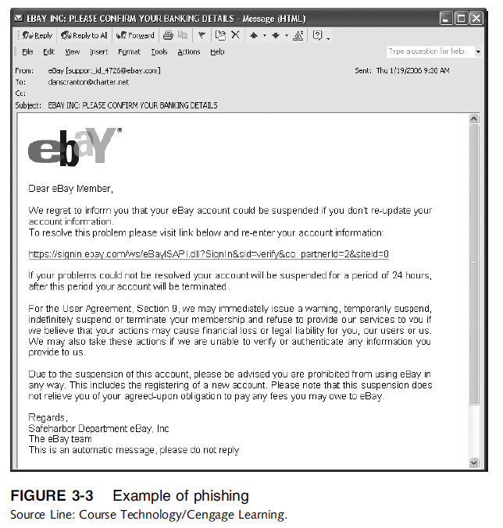
Ethics in Information Technology, Fourth Edition

Slide 21
Types of Perpetrators
Perpetrators include:
  Thrill seekers wanting a challenge
  Common criminals looking for financial gain
  Industrial spies trying to gain an advantage
  Terrorists seeking to cause destruction
Different objectives and access to varying resources
Willing to take different levels of risk to accomplish an objective
Ethics in Information Technology, Fourth Edition
Notes:
21

Slide 22
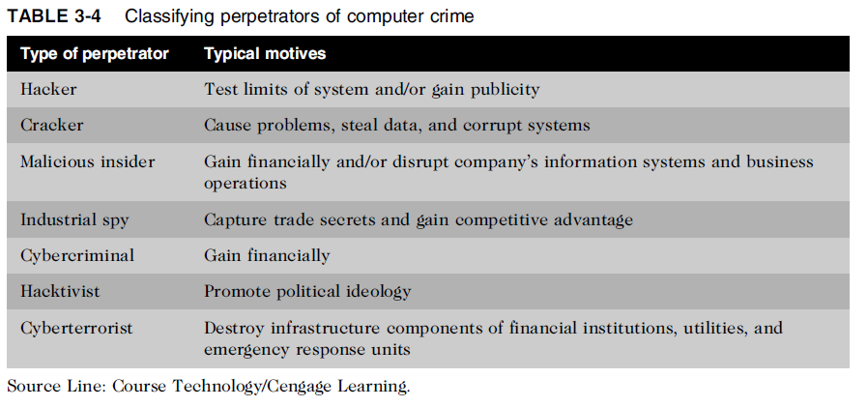
Types of Perpetrators (cont’d.)
Ethics in Information Technology, Fourth Edition
Notes:
22

Slide 23
Hackers and Crackers
Hackers
  Test limitations of systems out of intellectual curiosity
    Some smart and talented
    Others inept; termed “lamers” or “script kiddies”
Crackers
  Cracking is a form of hacking
  Clearly criminal activity
Ethics in Information Technology, Fourth Edition
Notes:
23

Slide 24
Malicious Insiders
Major security concern for companies
Fraud within an organization is usually due to weaknesses in internal control procedures
Collusion
  Cooperation between an employee and an outsider
Insiders are not necessarily employees
  Can also be consultants and contractors
Extremely difficult to detect or stop
  Authorized to access the very systems they abuse
Negligent insiders have potential to cause damage
Ethics in Information Technology, Fourth Edition
Notes:
24

Slide 25
Industrial Spies
Use illegal means to obtain trade secrets from competitors
Trade secrets are protected by the Economic Espionage Act of 1996
Competitive intelligence
  Uses legal techniques
  Gathers information available to the public
Industrial espionage
  Uses illegal means
  Obtains information not available to the public
Ethics in Information Technology, Fourth Edition
Notes:
25

Slide 26
Cybercriminals
Hack into corporate computers to steal
Engage in all forms of computer fraud
Chargebacks are disputed transactions
Loss of customer trust has more impact than fraud
Ethics in Information Technology, Fourth Edition
Notes:
26

Slide 27
Hacktivists and Cyberterrorists
Hacktivism
  Hacking to achieve a political or social goal
Cyberterrorist
  Attacks computers or networks in an attempt to intimidate or coerce a government in order to advance certain political or social objectives
  Seeks to cause harm rather than gather information
  Uses techniques that destroy or disrupt services
Ethics in Information Technology, Fourth Edition

Slide 28
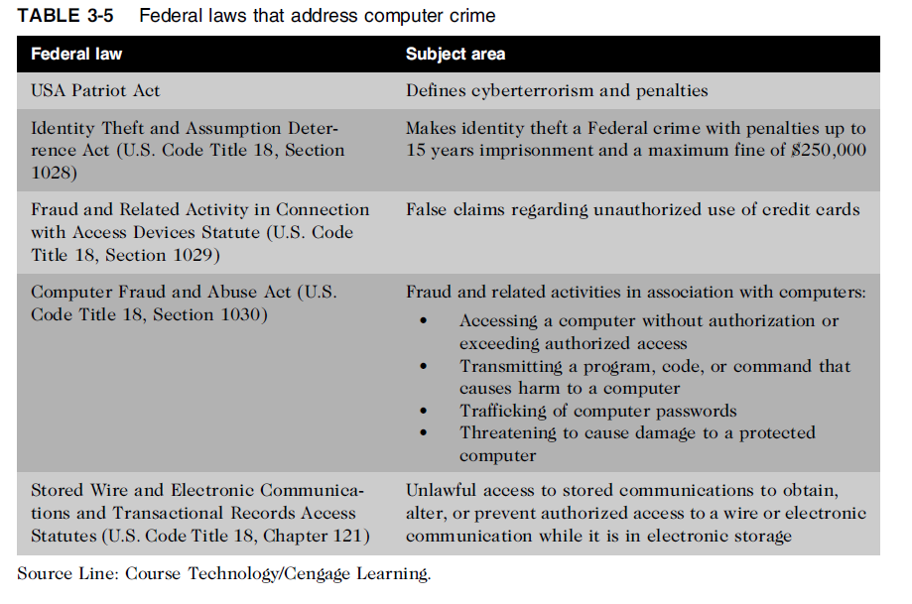
Federal Laws for Prosecuting Computer Attacks
Ethics in Information Technology, Fourth Edition

Slide 29
Summary
Ethical decisions in determining which information systems and data most need protection
Most common computer exploits
  Viruses
  Worms
  Trojan horses
  Distributed denial-of-service attacks
  Rootkits
  Spam
  Phishing, spear-fishing, smishing, vishing
Ethics in Information Technology, Fourth Edition
Notes:
29

Slide 30
Summary (cont’d.)
Perpetrators include:
  Hackers
  Crackers
  Malicious insider
  Industrial spies
  Cybercriminals
  Hacktivist
  Cyberterrorists
Ethics in Information Technology, Fourth Edition
Notes:
30

Slide 31
Summary (cont’d.)
Must implement multilayer process for managing security vulnerabilities, including:
  Assessment of threats
  Identifying actions to address vulnerabilities
  User education
IT must lead the effort to implement:
  Security policies and procedures
  Hardware and software to prevent security breaches
Computer forensics is key to fighting computer crime in a court of law
Ethics in Information Technology, Fourth Edition
Notes:
31

